Slide 1
Multi-Class Segmentation
advanced track

Slide 2


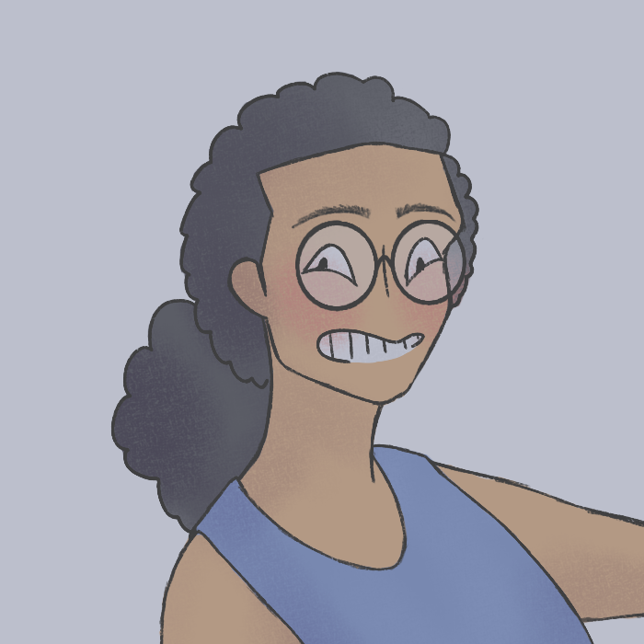
WHO ARE WE ?
BME Senior Students
Hussin
Elrashidy
Abdelrahman Abdelghany
Mariam
Bebawy

Slide 3
#1 Problem Definition
Animal body-parts Segmentation

Slide 4
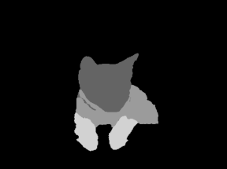
Animal body-parts Segmentation
WHY ?
Initial step for disease identification in different body parts

Slide 5
#2 ML Cycle

Slide 6
ML Cycle
iterate
data
evaluate
code

Slide 7
DATA
CODE
EVALUATE
ML Cycle
Image resizing to (256, 256)
Reading images with corresponding encodings
Splitting into train and validation sets ~ 80, 20 % split
already provided
Data processing & splitting
Model definition &training
Result checking & evaluation
main code steps
Optimizer = Adam optimizer
Loss = Dice loss
Metrics = IOU ~ Intersection Over Union
metrics used

Slide 8
ITERATE
ITERATE
Segmentation Approaches
Learning Rates
Optimizers
ML Cycle
UNet + EfficientNetB7
IOU ~ 0.63
UNet + ResNet34
IOU ~ 0.52
PSPNet + ResNext50
IOU ~ 0.48
FPN + EfficientNetB3
IOU ~ 0.59
0.1
downright bad results
almost no convergence
0.01
noisy but tolerable
as much time as default
0.001
best results
default value for a reason
Adam Optimizer
RMSprop Optimizer

Slide 9
#3 Approach Criticism

Slide 10
Innovation ?
Architectures have been around for a while
Depending on previous experience
Final results are good or bad based on one’s own perspective

Slide 11
Unet > FPN > PSPNet
EfficientNet > ResNet > ResNext
ADAM > RMSprop
Comparisons

Slide 12
#3 Results

Slide 13
Metrics
Inference Time
IOU Score
DICE Loss
Results
test set:
~ 21 sec
single sample:
~ 0.12 sec
training:
~ 0.7338
validation:
~ 0.6314
training:
~ 0.3404
validation:
~ 0.4444

Slide 14
Segmentation Results
are the results any good ?

Slide 15
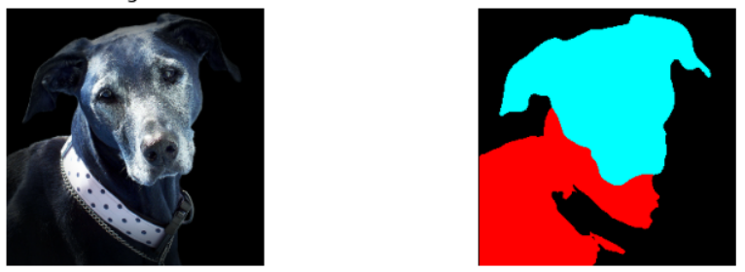
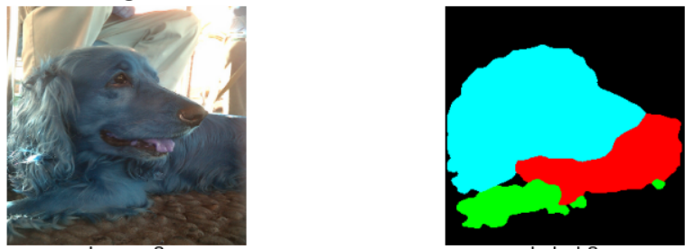
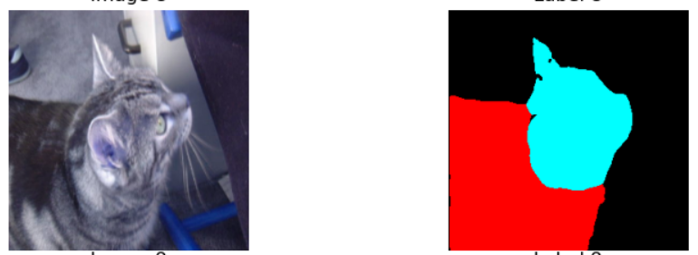
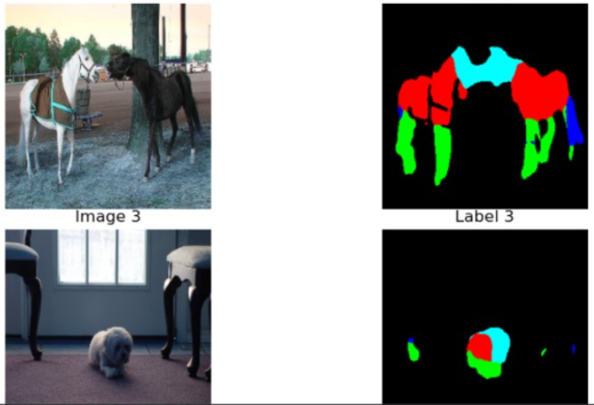
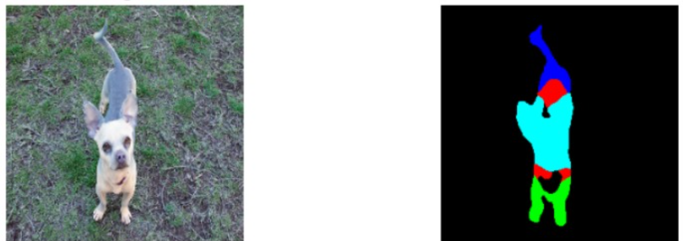

Slide 16
THANK YOU FOR HAVING US !
emails
hussin.mhmd@gmail.com
abdelrahman.abdelghany.22@gmail.com
mariam.m.bebawy@gmail.com
linkedin
linkedin.com/in/hussin-elrashidy
linkedin.com/in/abdelrahman-abdelghany
linkedin.com/in/mariam-bebawy

